Slide 1
ETWINNING
ENVIRONMENTAL PROTECTION

Slide 2
The Aim
During the project pupils prepared posters and presentations on environmental issues, which were uploaded to the ETWINNING platform with a description. The works payed special attention to current environmental problems, and ways to prevent them.

Slide 3
Project objectives:
1. to build awareness among young people about the problems faced by the environment
2. to get acquainted with ways of preventing environmental pollution
3. using IT and traditional tools
4. to make contact with peers from other countries

Slide 4
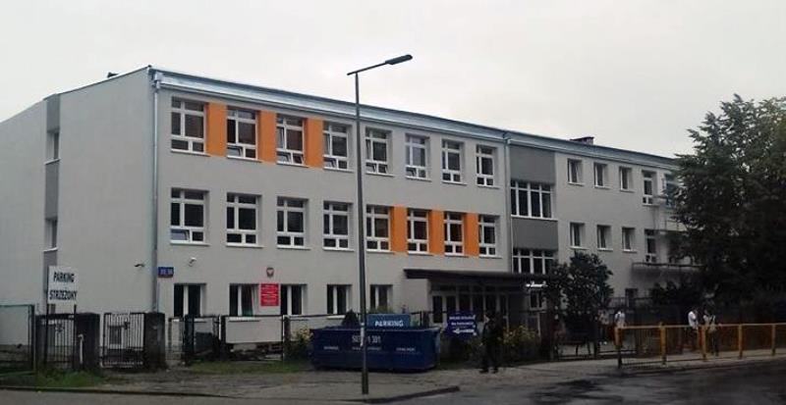
POLAND
Zespół Szkół Gastronomiczno – Hotelarskich w Warszawie

Slide 5
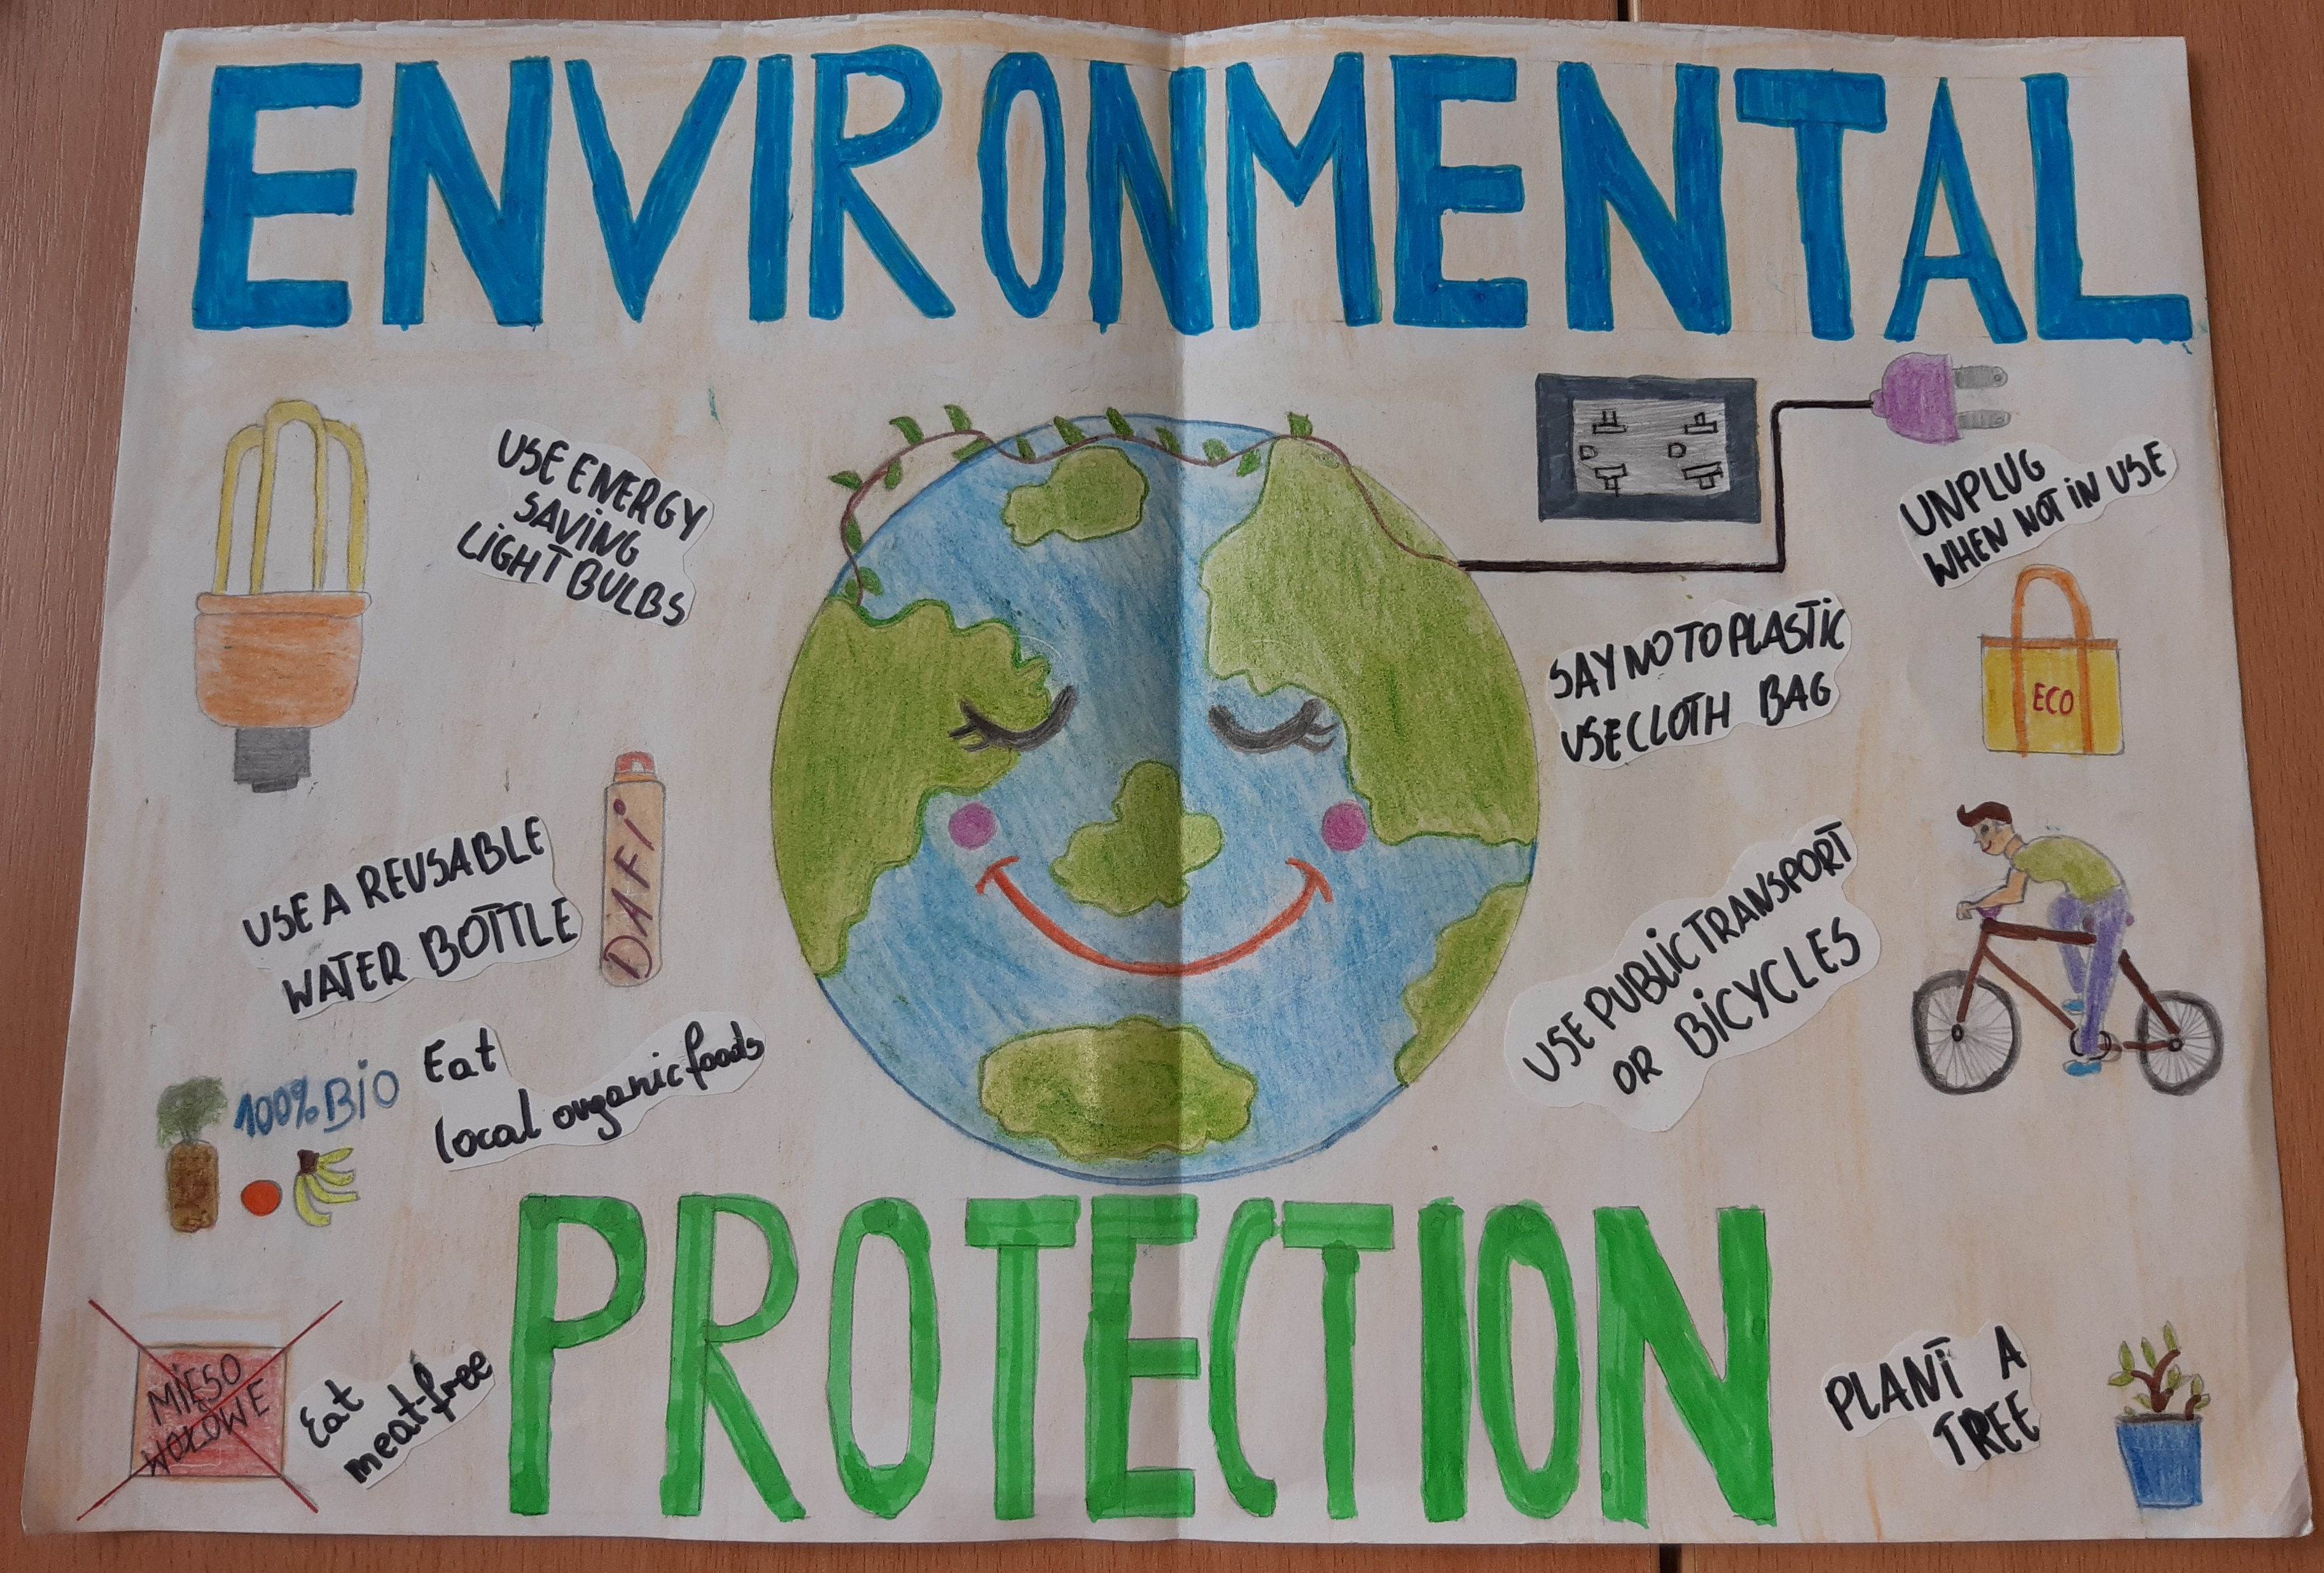

Slide 6
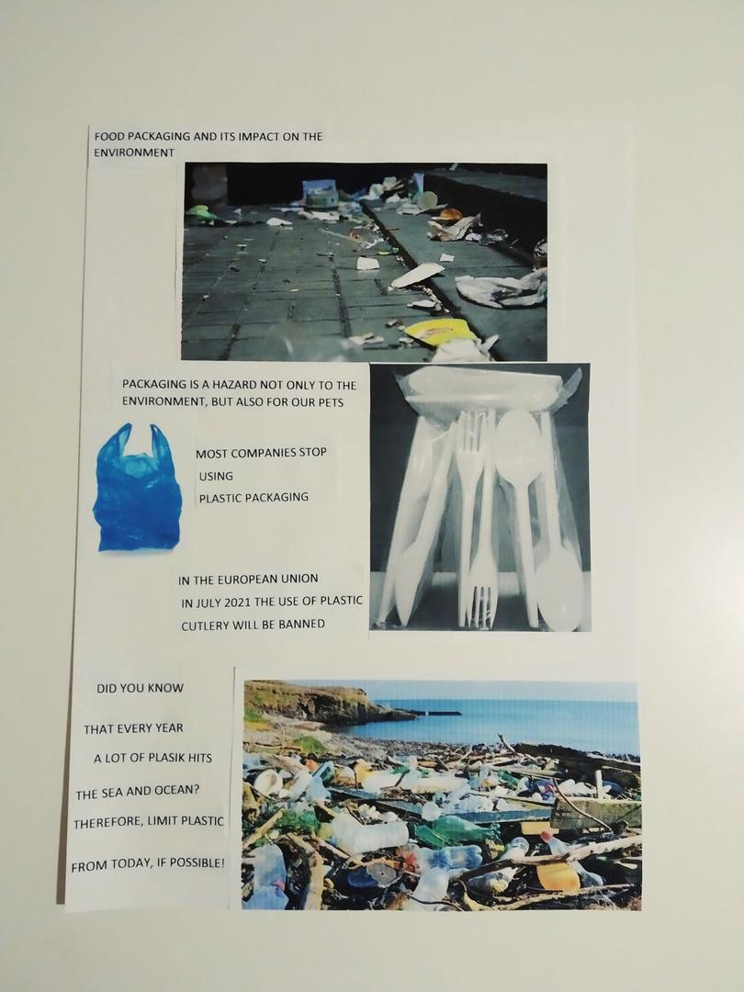

Slide 7
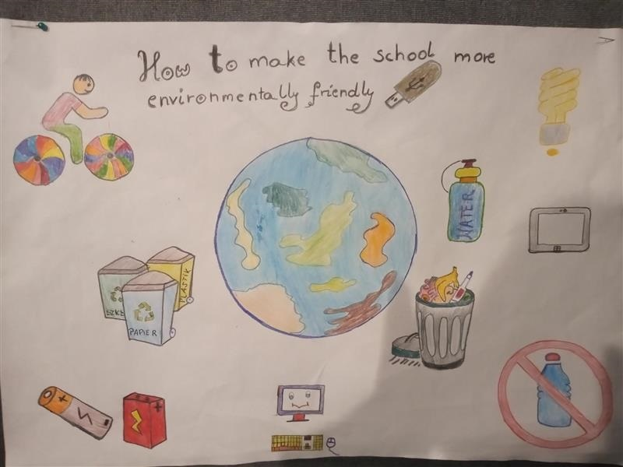

Slide 8
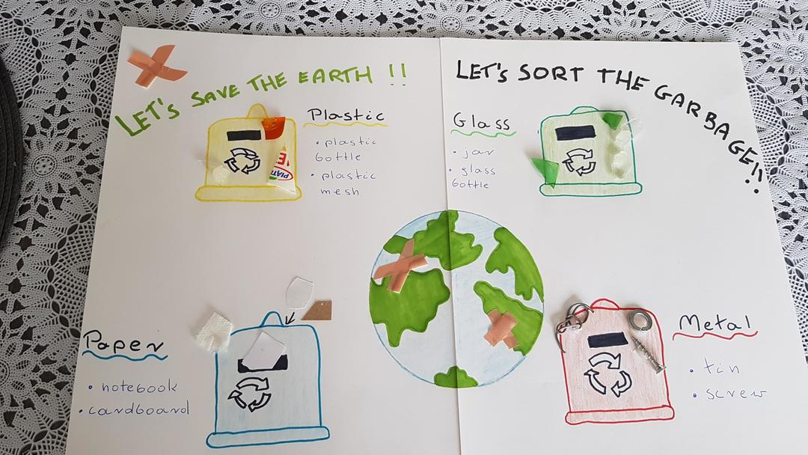

Slide 9
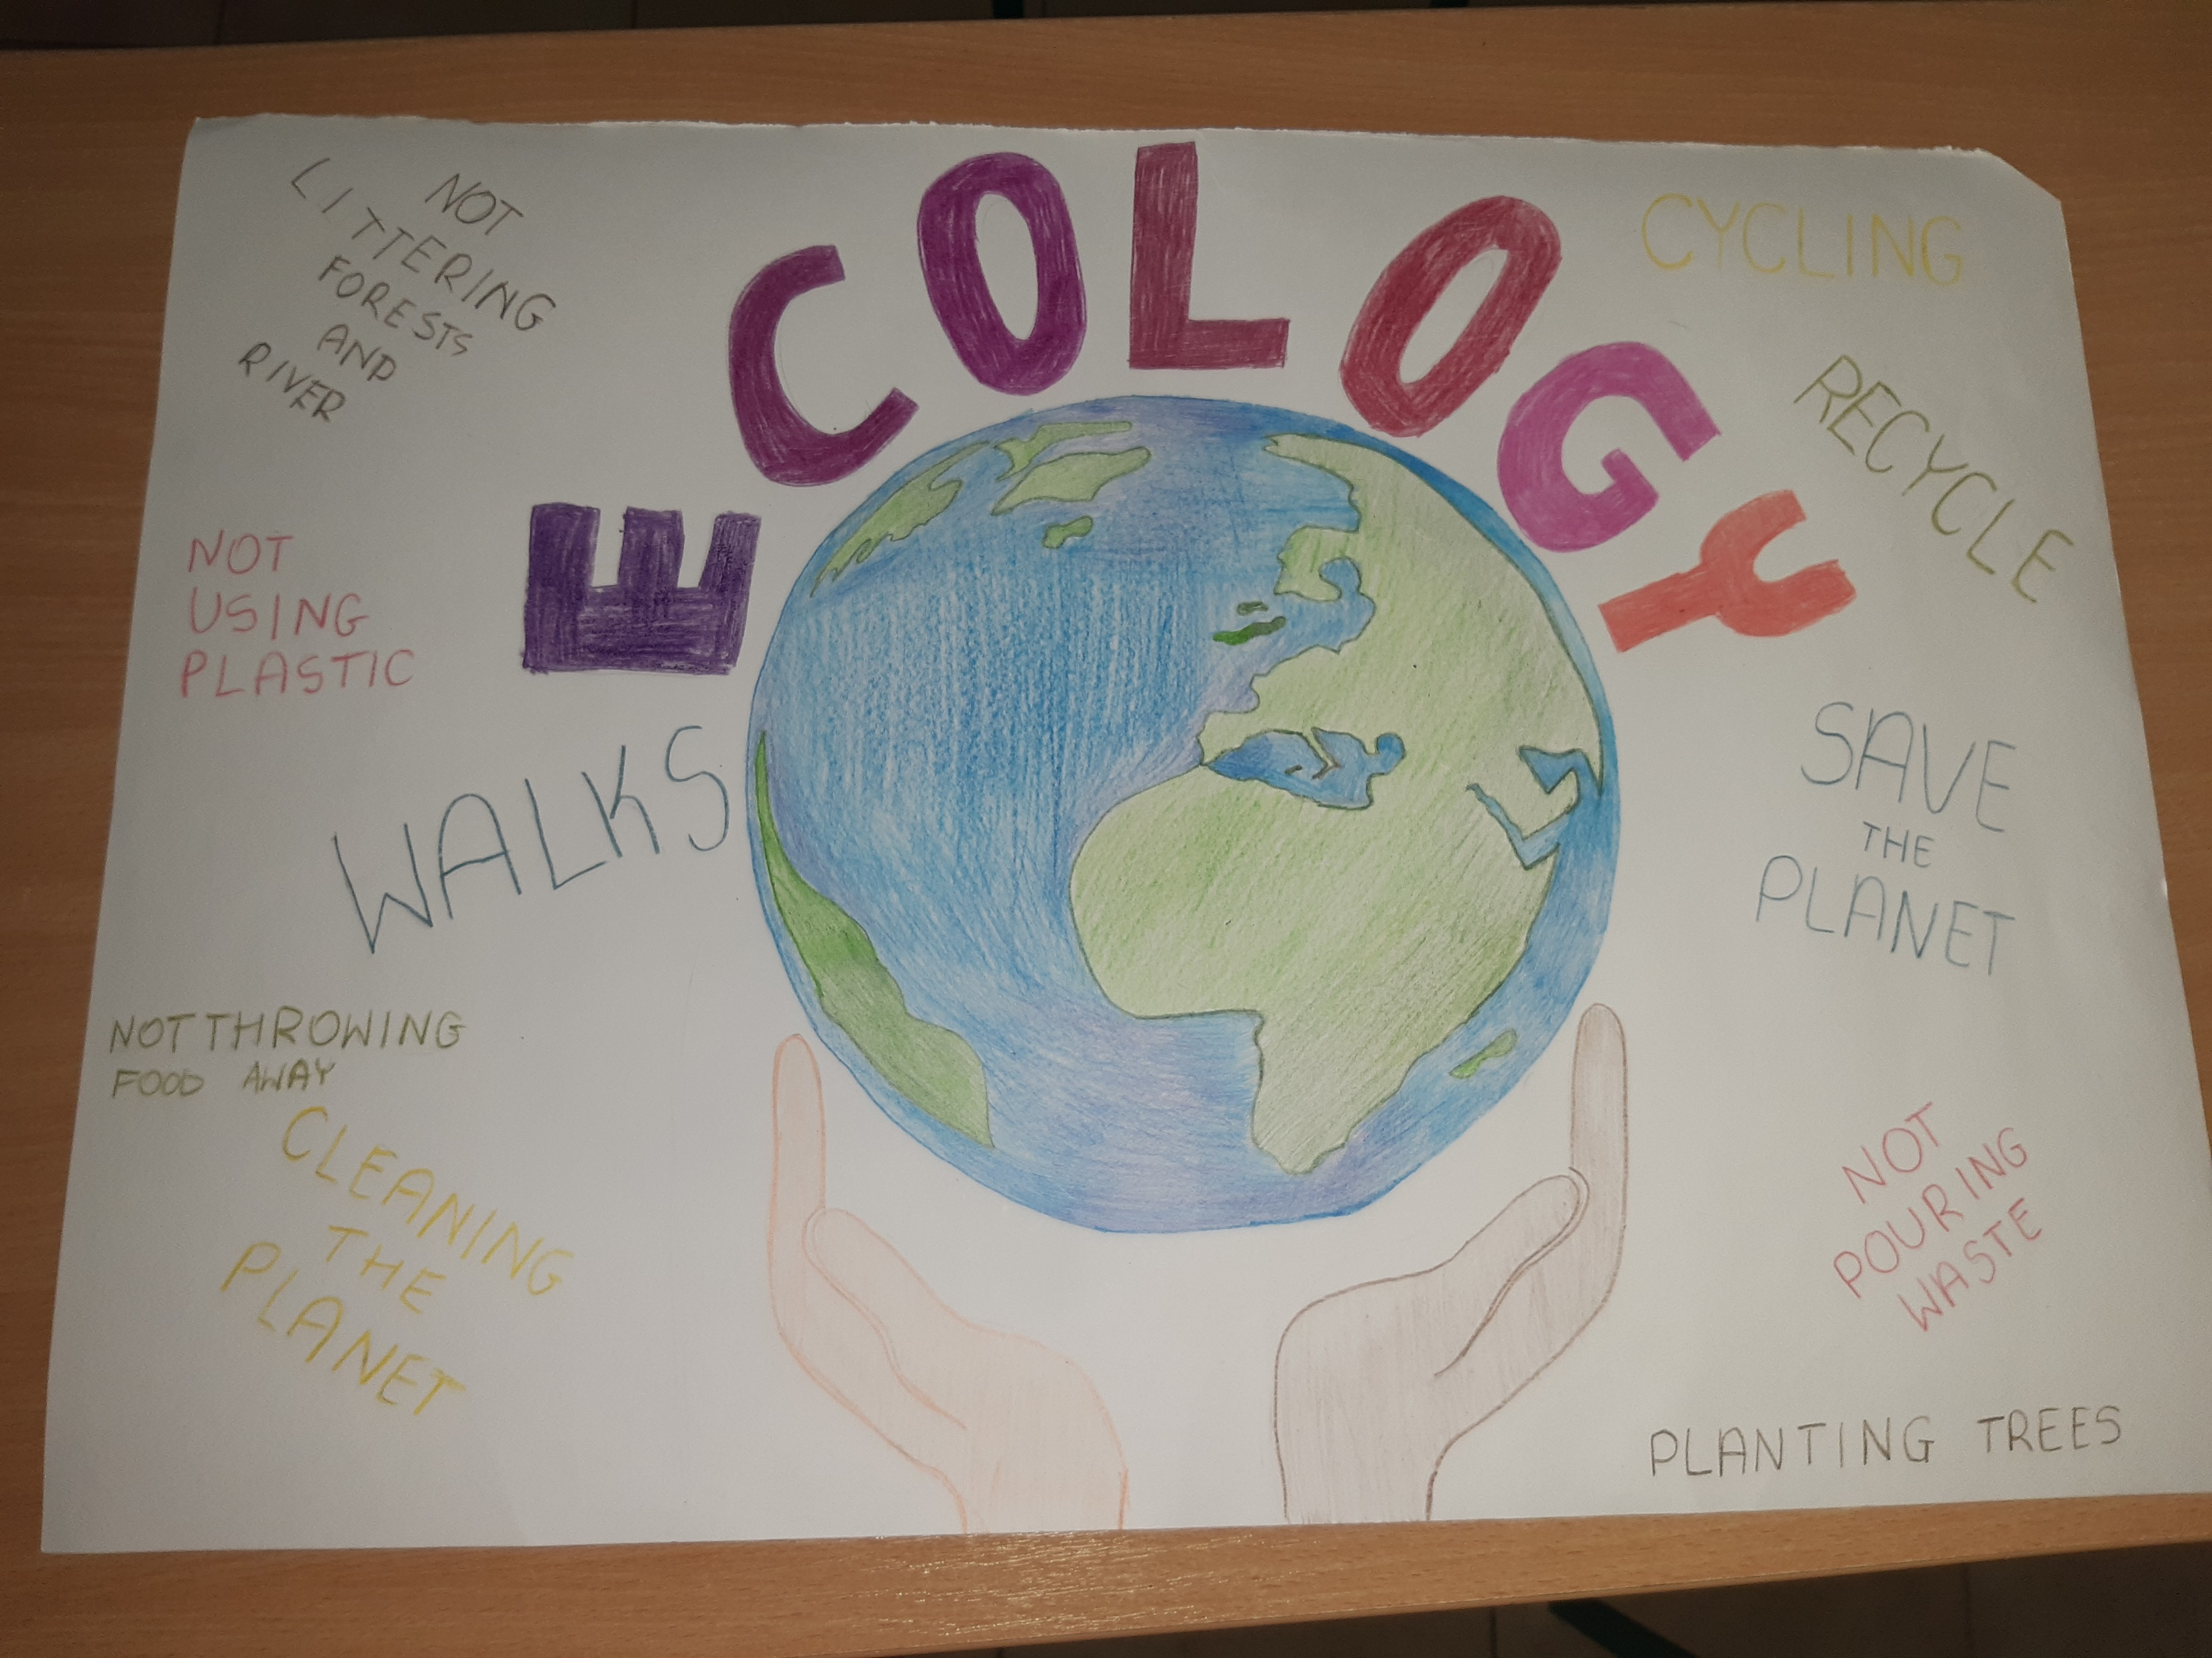

Slide 10
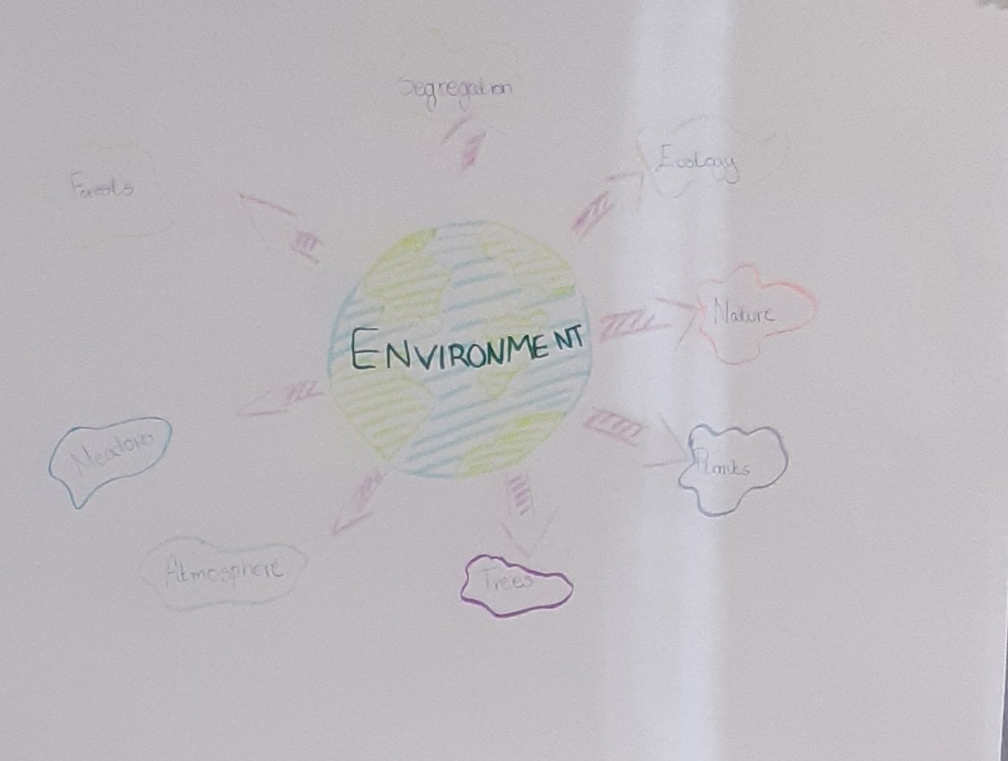

Slide 11
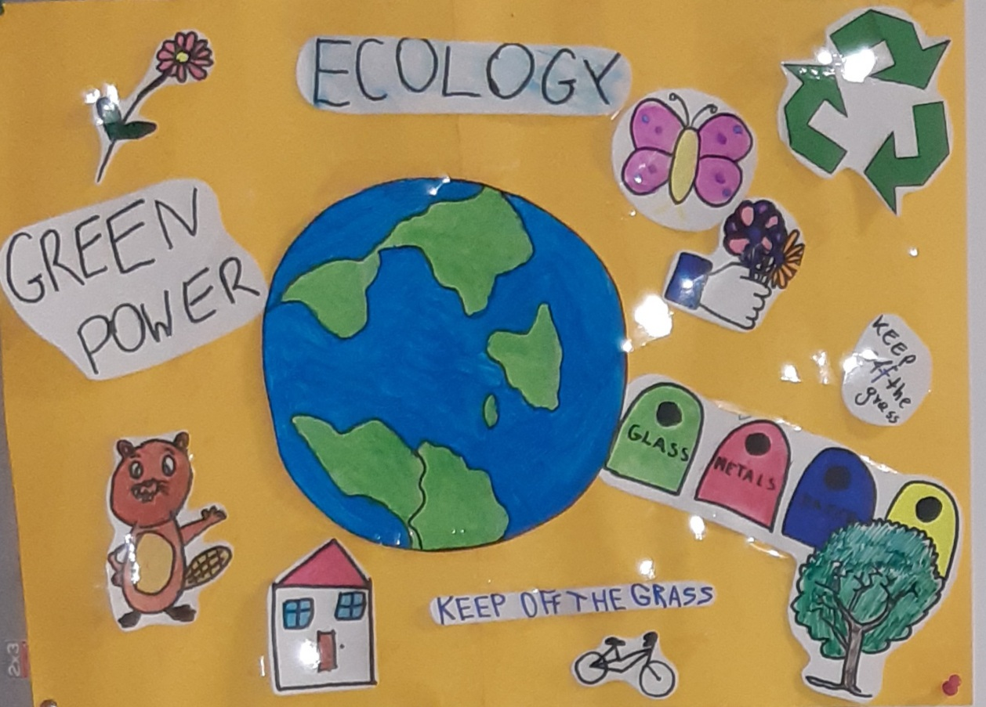

Slide 12
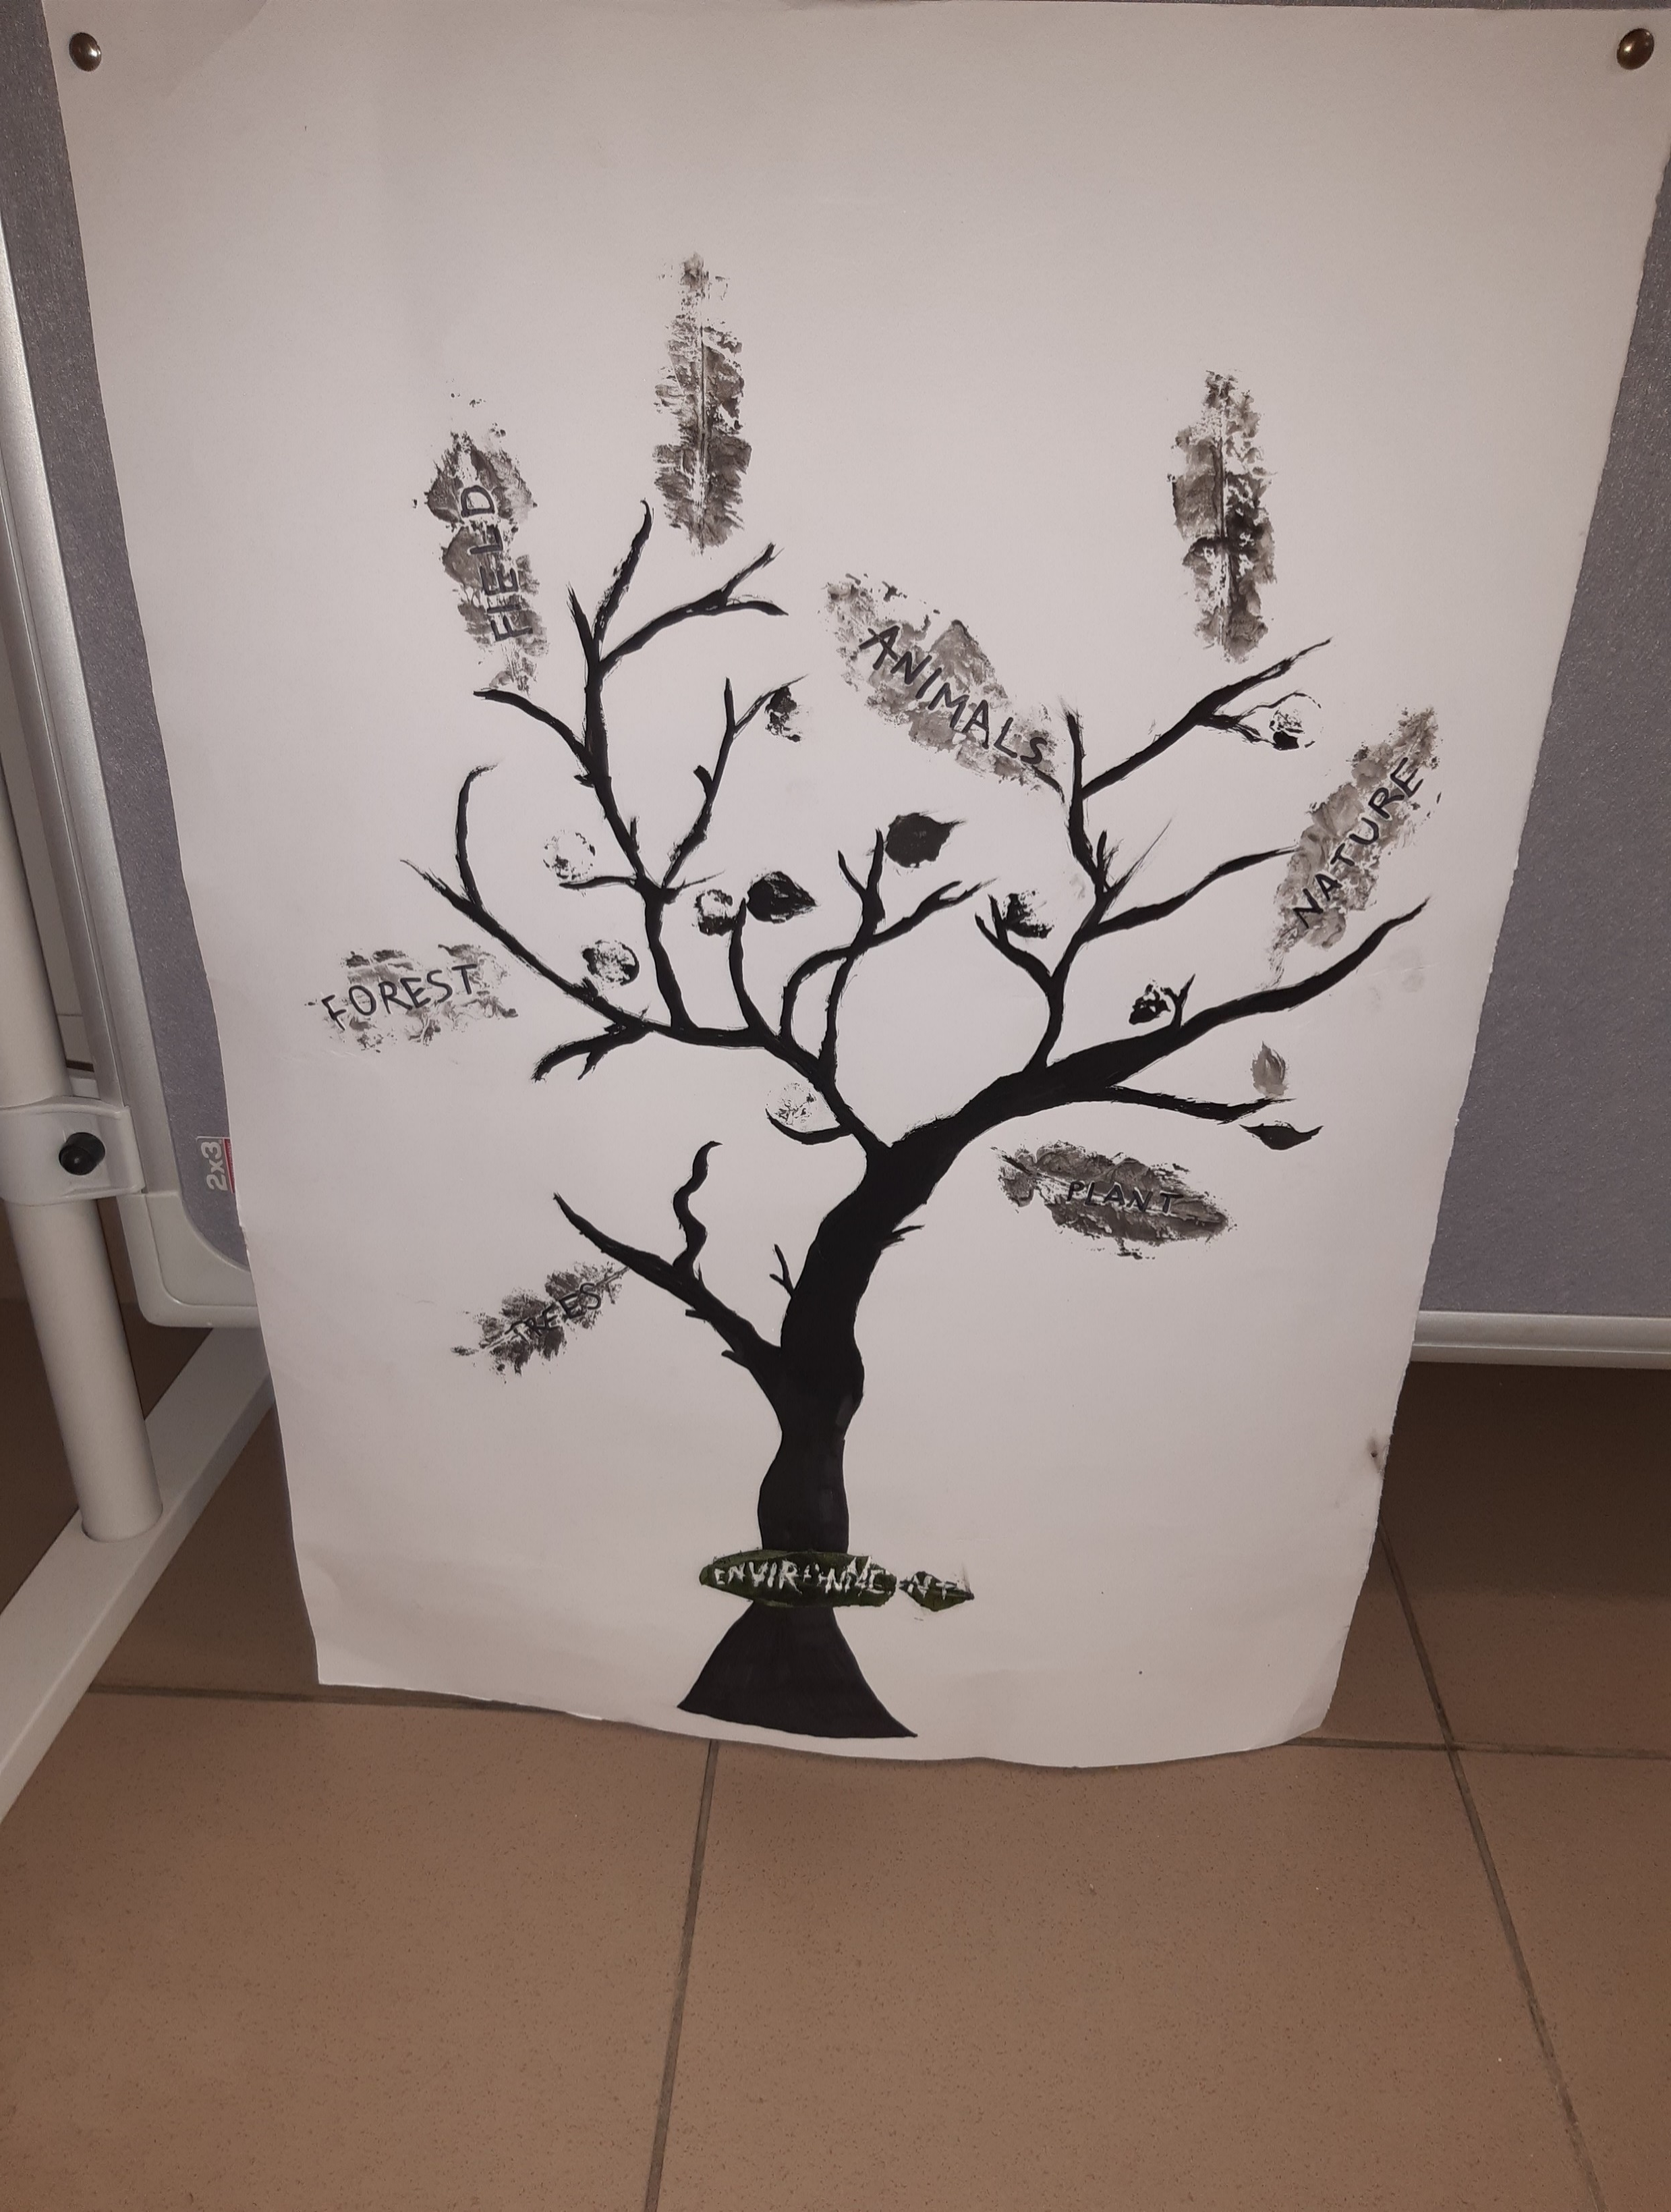

Slide 13
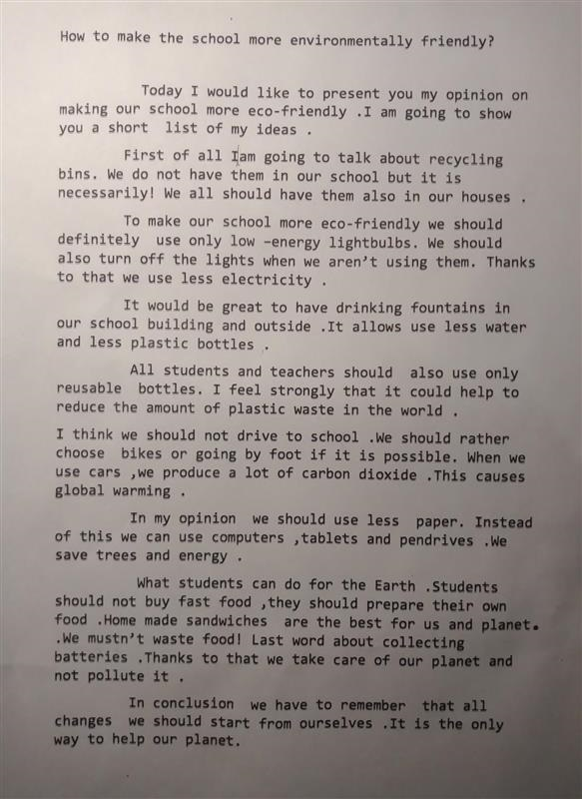
https://youtu.be/2YUGyY-GgO4

Slide 14
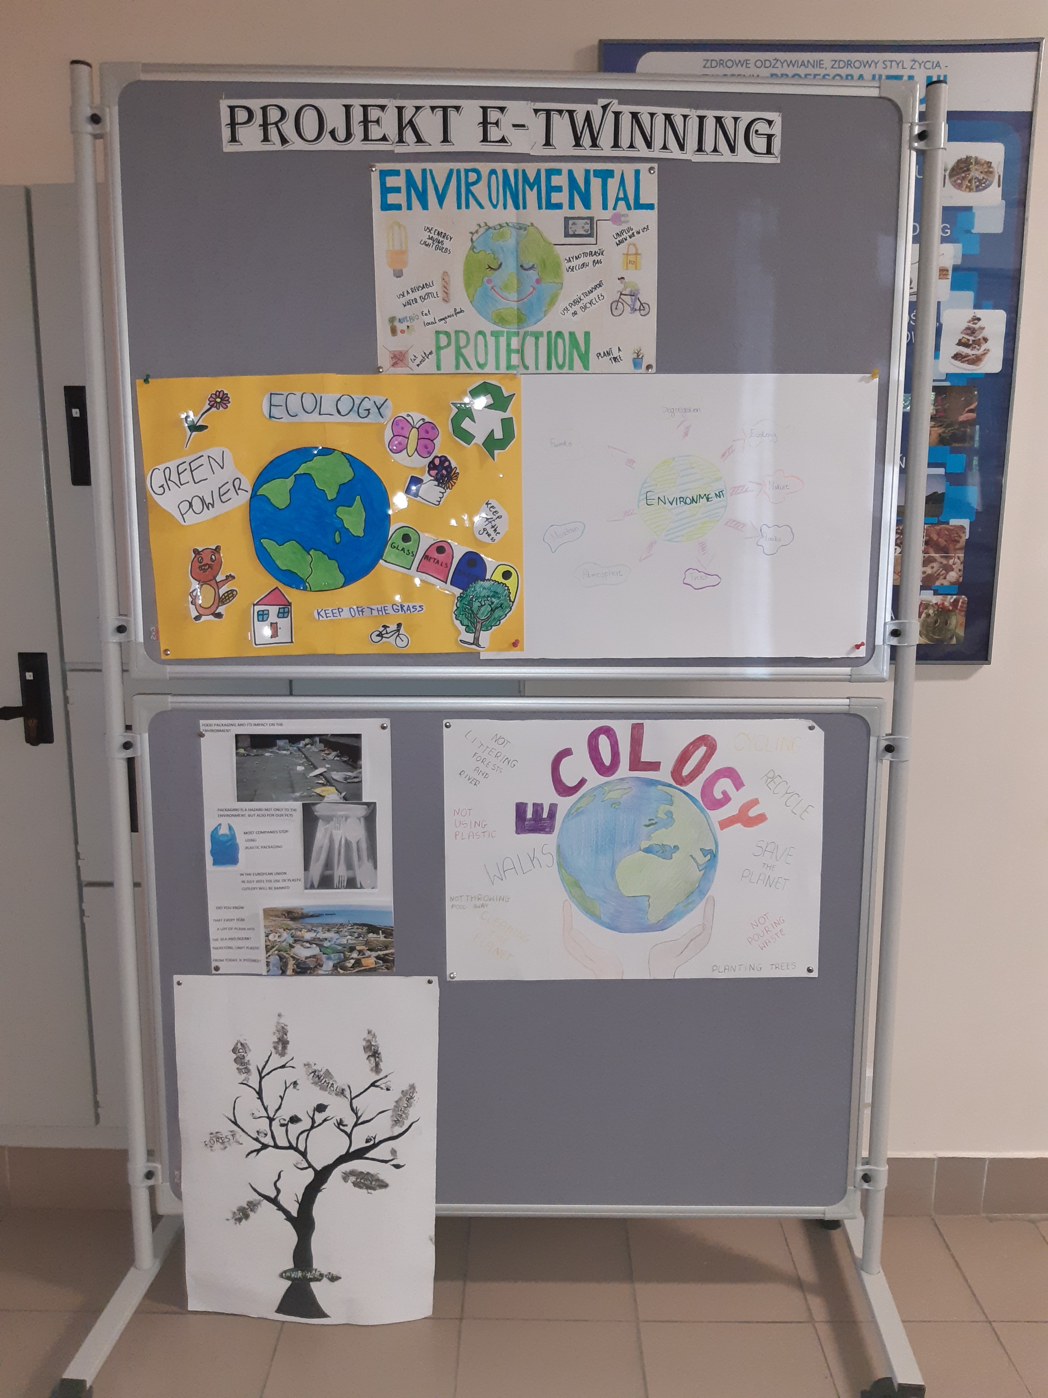

Slide 15
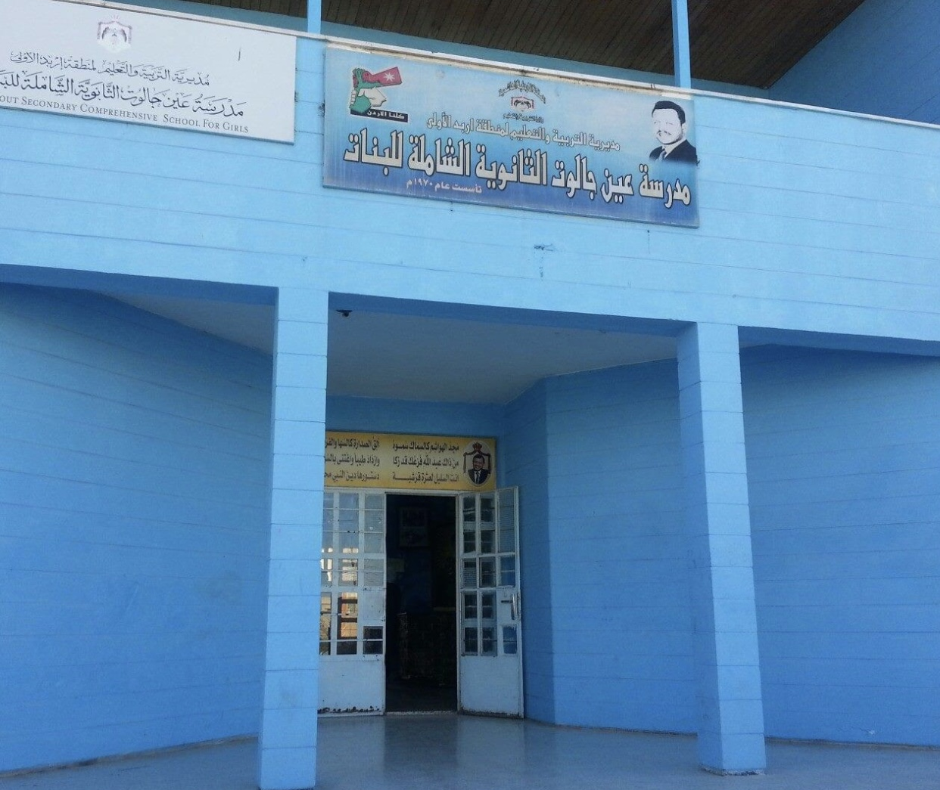
JORDAN
Ein Jalout Comprehensive Secondary School for Girls in Irbid

Slide 16
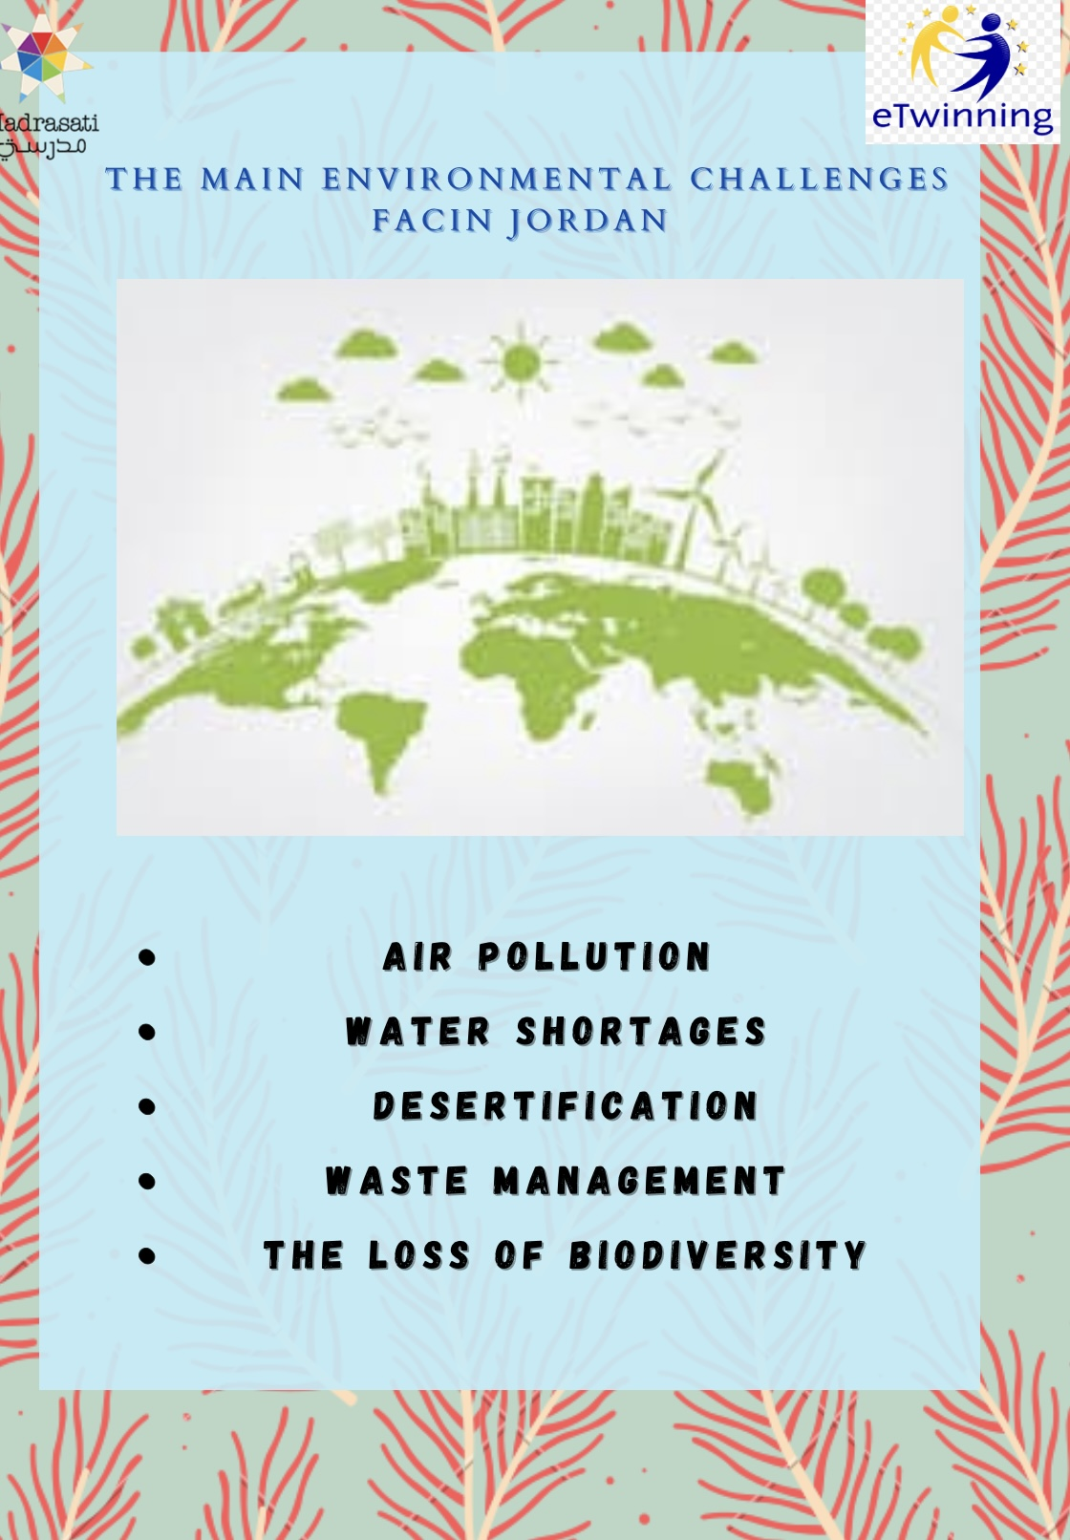

Slide 17
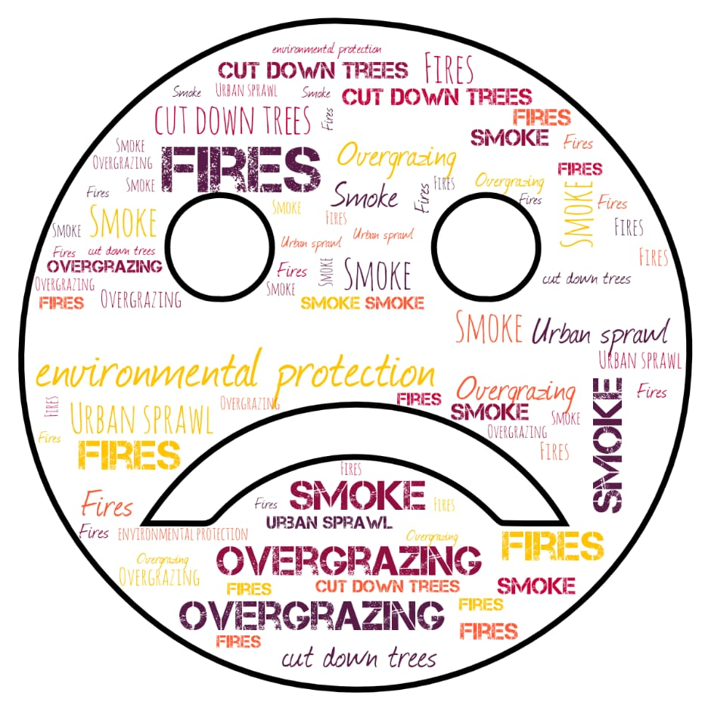

Slide 19
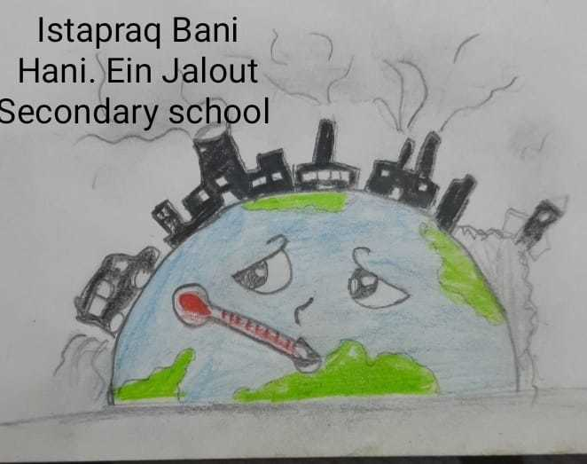

Slide 20
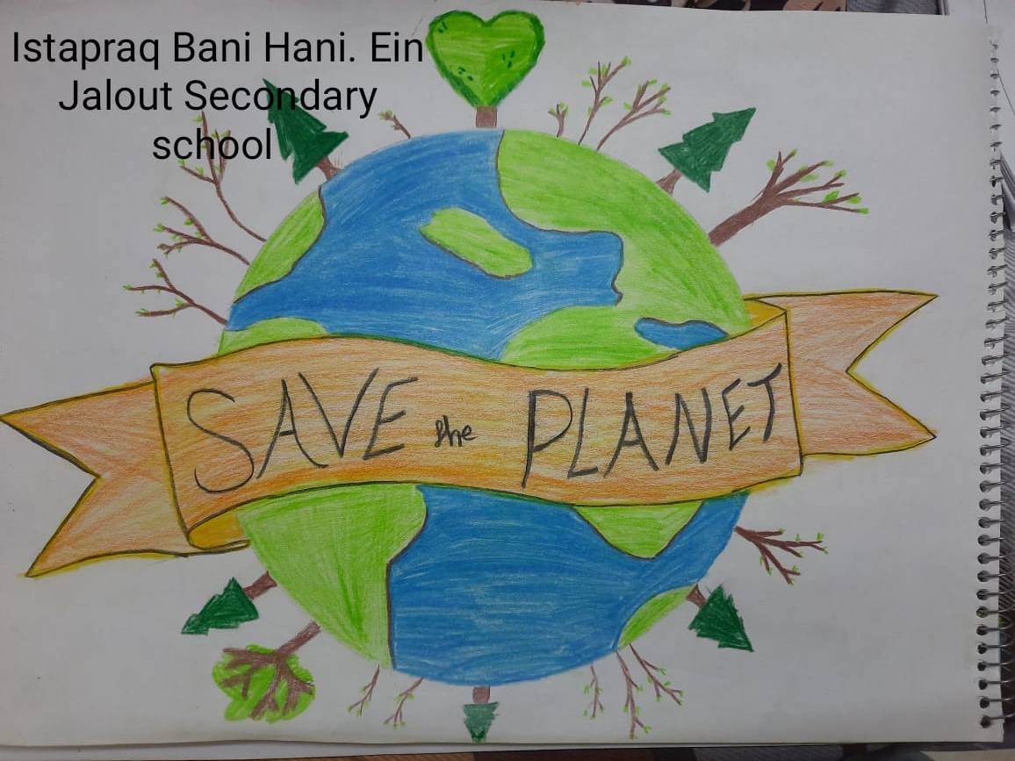

Slide 21
Sources
https://www.zsgh.edu.pl/pl/top-menu/o-szkole/kontakt-2.html
https://twinspace.etwinning.net/176545/home

